Slide 1


WhatsApp Automation

Slide 2
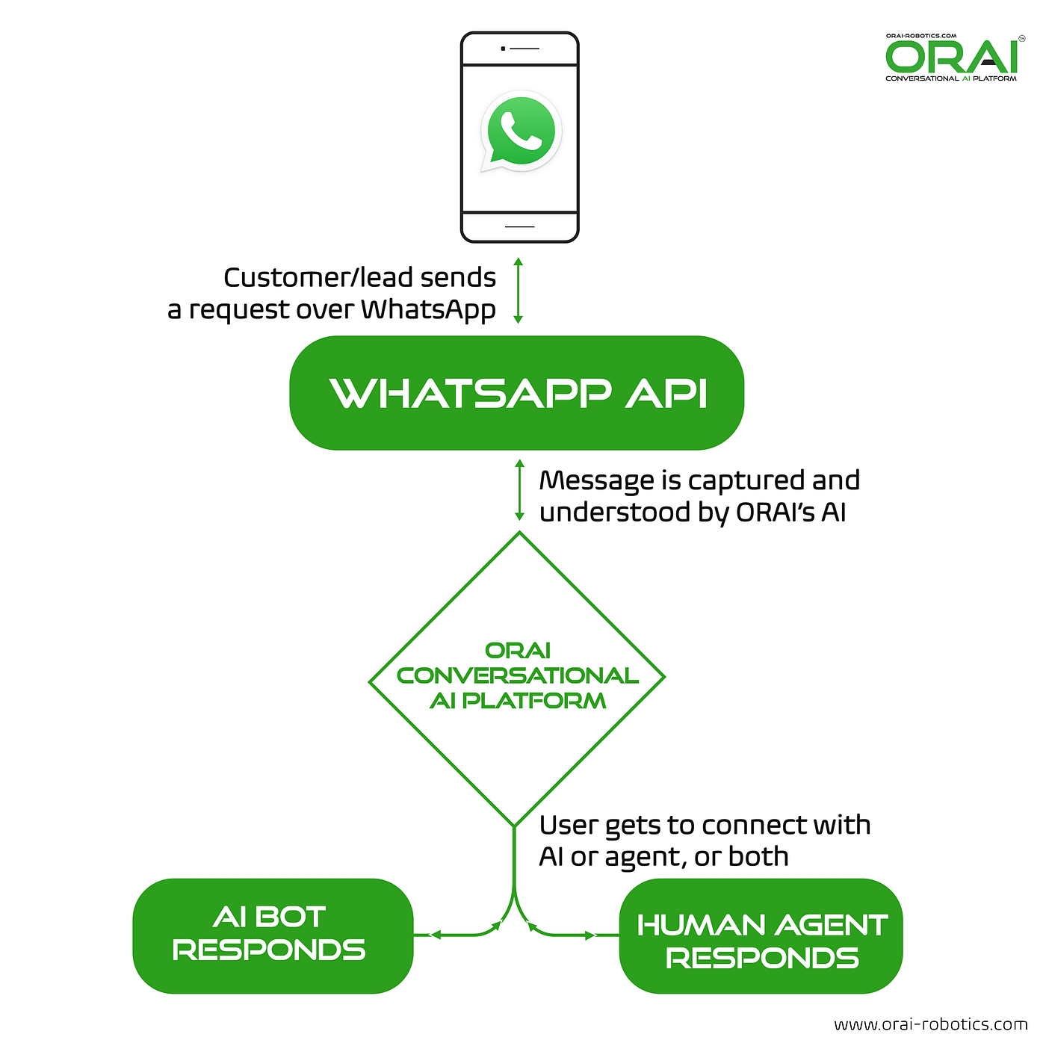

Slide 3
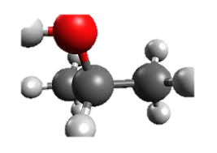
Introduction to WhatsApp Automation Project
In an age of constant communication and digital connectivity, WhatsApp has emerged as one of the most widely used messaging platforms worldwide. Leveraging the power of automation within WhatsApp can significantly enhance productivity, streamline processes, and improve user experiences. This introduction provides an overview of our WhatsApp automation project, outlining its objectives and the value it brings to both individuals and businesses.

Slide 4
Project Objectives
Efficient Customer Service : Automating responses to common queries and inquiries, providing instant support, and ensuring timely customer engagement.
Personal Productivity : Automating repetitive tasks, such as sending routine messages or reminders, to free up time for more important activities.
Appointment Scheduling : Automating the process of scheduling appointments, reminders, and confirmations for businesses and professionals.

Slide 5

Advantages
Time Savings: Automation reduces the need for manual intervention, saving time and allowing users to focus on more critical tasks.
Consistency: Automated responses ensure that users receive consistent and accurate information every time.
Enhanced User Experience: Faster response times and personalized messages improve the overall experience for WhatsApp users.

Slide 6
Automate WhatsApp Messages Using Module
Automate WhatsApp Messages With Python using Pywhatkit module. We can automate a Python script to send WhatsApp messages. In this article, we will learn the easiest ways using Pywhatkit module that the website web.whatsapp.com uses to automate the sending of messages to any WhatsApp number.

Slide 7
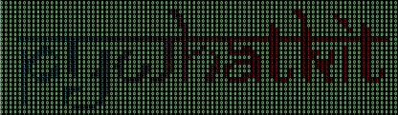
PyWhatKit Module
PyWhatKit is a Python library with various helpful features. It's easy-to-use and does not require you to do any additional setup. Currently, it is one of the most popular library for WhatsApp and YouTube automation. New updates are released frequently with new features and bug fixes.

Slide 8

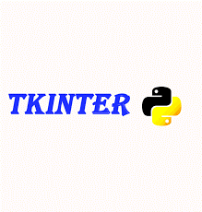
Tkinter Toolkit
Tkinter is a Python binding to the Tk GUI toolkit. It is the standard Python interface to the Tk GUI toolkit, and is Python's de facto standard GUI. Tkinter is included with standard Linux, Microsoft Windows and macOS installs of Python.

Slide 9
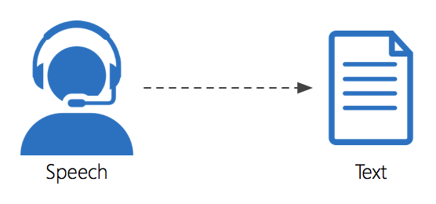
Speech Recognition
Speech recognition technology is capable of converting spoken language (an audio signal) into written text that is often used as a command. Today's most advanced software can accurately process varying language dialects

Slide 10
THANK YOU !!

